Slide 1
SQL Programming
Joining Tables – Part 3

Slide 2
Module 10: Joins via FROM Page A-1: Intro
In this module we’ll continue our discussion on joining tables and discuss a feature that was introduced in the SQL-1992 version of the standard.
This feature allows the programmer to specify the type of table join in the FROM clause.
The pre-requisites for this module are the prior units on Joins. You need to have studied, and used, the WHERE clause technique for forming joins before you start this module.

Slide 3
Module 10: Joins via FROM Page A-2: SQL Process Model
Before we jump into this unit, let’s take a moment to reflect on the SQL Processing Model that we’ve been using.
The FROM clause gets things going by creating the first working table based on the tables that are named in this clause.
Then the WHERE clause kicks in and identifies the rows from the first working table that are to be kept, and carried forward for further processing.
Eventually the SELECT clause will apply to specify the columns that are to be listed in the final result table.
In my simple way of thinking:
FROM deals with tables
WHERE deals with rows
SELECT deals with columns

Slide 4
Module 10: Joins via FROM Page A-3: SQL Process Model
And to my way of thinking, since joins are a table operation, it would make a whole lot more sense for the join to be specified in the FROM clause rather than using the WHERE clause as we’ve been doing.
After all, the FROM clause is for table operations, and joining seems to be the ultimate table operation.
The good news is that the SQL-1992 standard finally got around to this way of thinking.
The bad news is that most vendors didn’t implement the feature until the 1999 standard was released.
But it’s there now, and I think it’s slightly more intuitive than the WHERE technique.

Slide 5
Module 10: Joins via FROM Page B-1: Joins
In this module, we’re going to revisit these joins:
Cross joins (B)
Equi-join (C)
Natural join (D)
Non-equi join (E)
Left outer join (F)
Right outer join (G)
Full outer join (H)

Slide 6
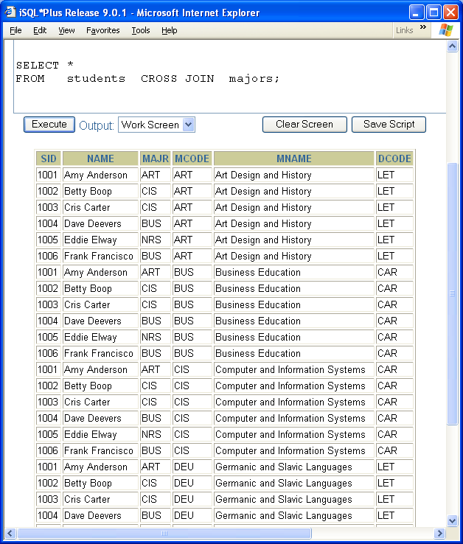
Module 10: Joins via FROM Page B-2: Cross Joins
We establish a CROSS JOIN in the ‘old’ technique by simply listing tables in the FROM clause.
For example:
SELECT *
FROM students, majors
In the newer technique we use the key phrase ‘CROSS JOIN’ as follows:
SELECT *
FROM students CROSS JOIN majors

Slide 7
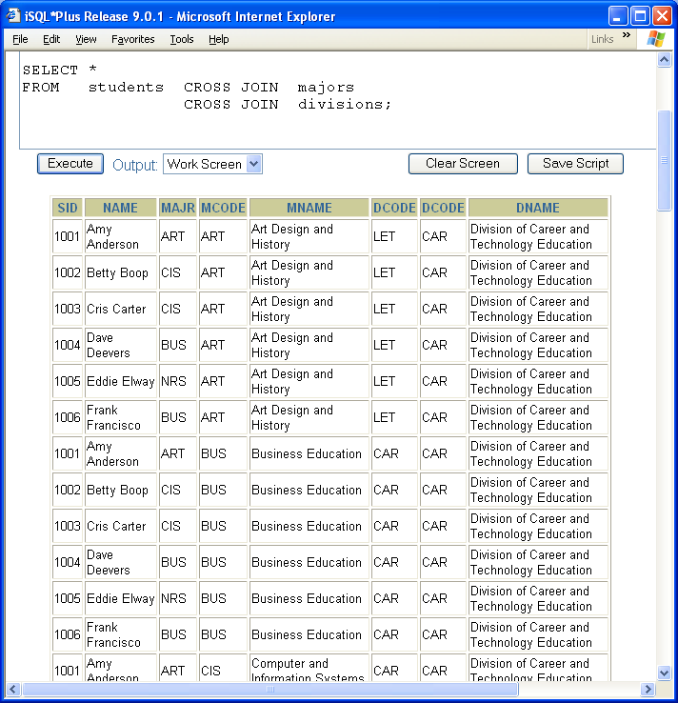
Module 10: Joins via FROM Page B-3: Cross Joins
In order to cross join more than two tables, link each pair of tables with another CROSS JOIN phrase.

Slide 8
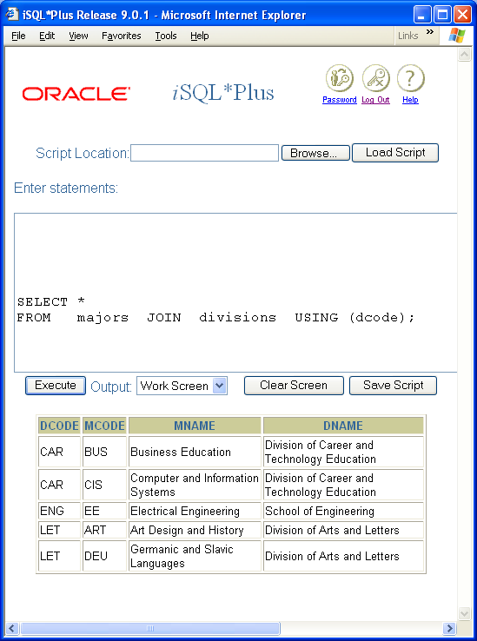
Module 10: Joins via FROM Page C-1: Equi-Joins
An equi-join is a join that is based on some equality condition.
In the older technique we would build an equality condition in our predicate expression to preserve those rows that matched that criterion.
SELECT *
FROM majors, divisions
WHERE majors.dcode = divisions.dcode
In the newer technique we have two options. We can use the JOIN/USING combination, or the JOIN/ON combination.
The rule for deciding which to use is pretty simple. If the joining column in each table has the same name, use USING, otherwise use ON.
Note: JOIN/USING defaults to a natural join in that the duplicated column is excluded in the final result table.

Slide 9
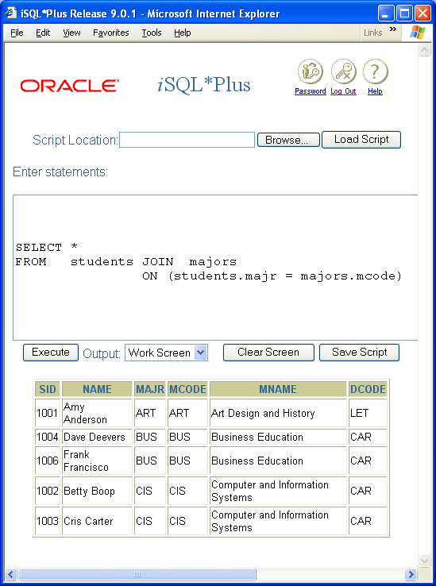
Module 10: Joins via FROM Page C-2: Equi-Joins
We can use the ON condition to perform an equi-join on different named columns.

Slide 10
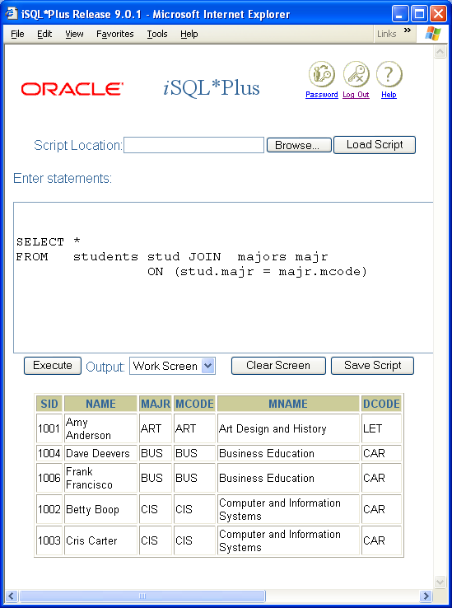
Module 10: Joins via FROM Page C-3: Table Aliases
In this example you can see that the use of join phrases in the FROM clause does not preclude the use of table aliases.

Slide 11
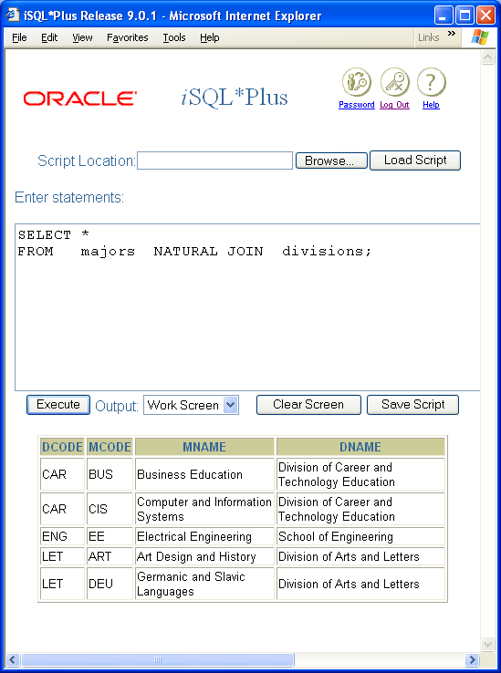
Module 10: Joins via FROM Page D-1: Natural Joins
A natural join is an equi-join that eliminates duplicate, or redundant, columns.
We’ve seen how the JOIN/USING combination can create a natural join.
We also have the option of explicitly stating a NATURAL JOIN as follows:
SELECT *
FROM majors NATURAL JOIN divisions;

Slide 12
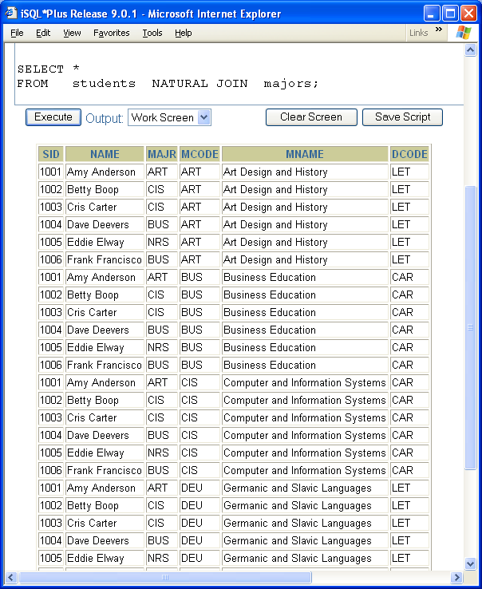
Module 10: Joins via FROM Page D-2: Natural Joins
The NATURAL JOIN technique only works when the tables are joined on same named columns.
In fact, a NATURAL JOIN uses all same named columns when joining tables.
In this example, the students and majors table do not share a same named column. Hence, this NATURAL JOIN effectively creates a CROSS JOIN. This is very misleading, and I think it’s a poor implementation of the standard!

Slide 13
Module 10: Joins via FROM Page D-3: Natural Joins
A natural join joins two (or more) tables based on same-named columns in the two tables.
Note: The presumption here is that all of these same-named columns are drawn from the same domain – this isn’t always the case, so be careful. Commonly used names such as id, name, state, status, … can yield “mysterious” results when used in natural joins. For example, an ID in a student table is probably not equivalent to an ID in a product table, nor is it likely that the NAME column in the student table is from the same domain as the NAME column in the COURSE table.

Slide 14
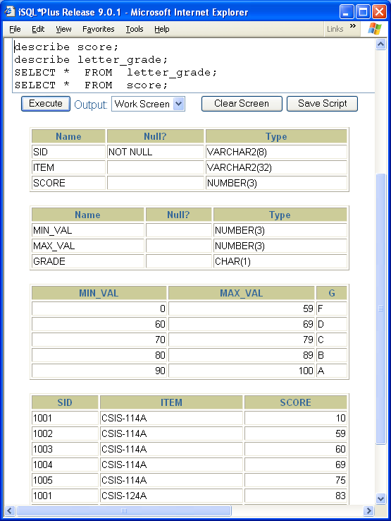
Module 10: Joins via FROM Page E-1: Non-Equi Joins
Earlier, we used the JOIN/ON combination to link two tables with different named columns.
SELECT *
FROM students stud JOIN majors majr
ON (stud.majr = majr.mcode)
We can also use the JOIN/ON combination to specify a non-equality condition.
If you recall the example we used in the previous lecture on joins, student test scores were in one table, and another table contained the letter grades that were to be assigned to the various grade ranges.
←

Slide 15
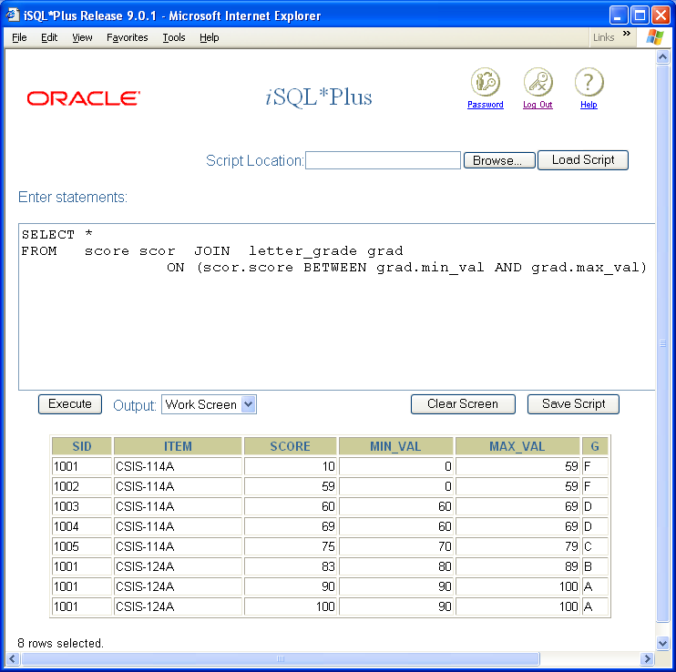
Module 10: Joins via FROM Page E-2: Non-Equi Joins
We used the BETWEEN operator to link the two tables.
We can accomplish the same task as follows:
SELECT *
FROM score scor JOIN letter_grade grad
ON (scor.score BETWEEN grad.min_val AND grad.max_val)

Slide 16
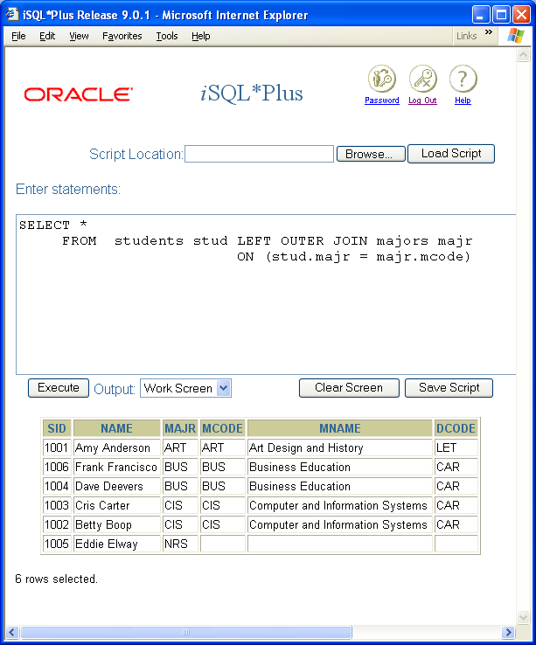
Module 10: Joins via FROM Page F-1: Left Outer Joins
A left outer join insures that all of the rows in the table on the left-hand side of the JOIN phrase are included.
The new technique uses the keywords: LEFT OUTER JOIN to specify a left outer join.

Slide 17
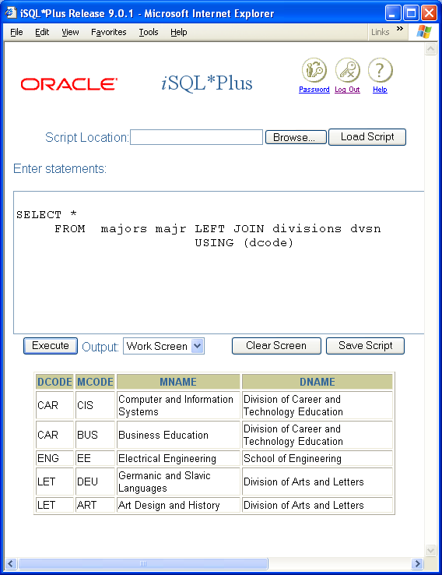
Module 10: Joins via FROM Page F-2: Left Outer Joins
We can also use the USING phrase if it applies.

Slide 18
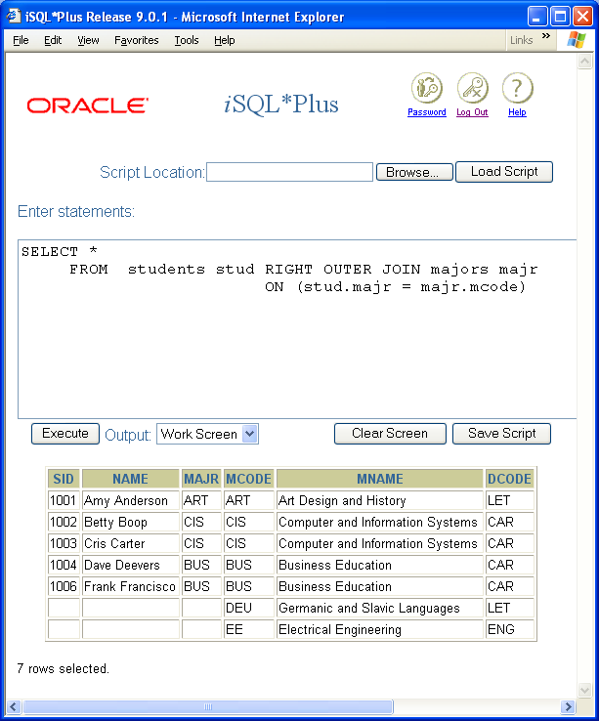
Module 10: Joins via FROM Page G-1: Right Outer Joins
A right outer join insures that all of the rows in the table on the right-hand side of the join phrase are included.
The new technique uses the keywords: RIGHT OUTER JOIN to specify a right outer join.
For example:
SELECT *
FROM students stud RIGHT JOIN majors majr
ON (stud.majr = majr.mcode)

Slide 19
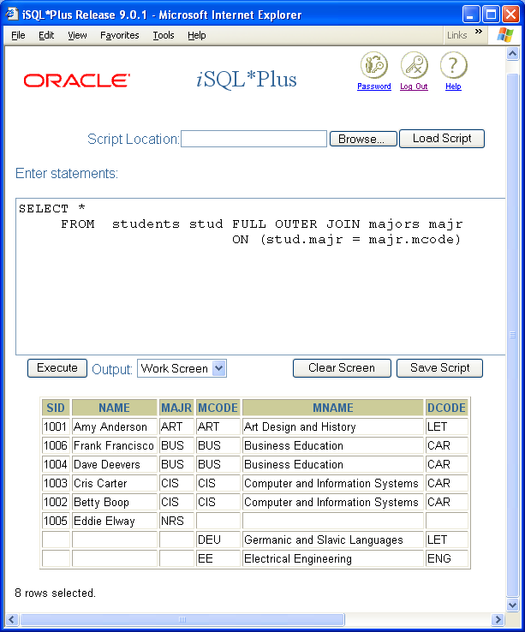
Module 10: Joins via FROM Page H-1: Full Outer Joins
A full outer join insures that all of the rows in each of the tables are represented in the result table.
The new technique uses the keywords: FULL OUTER JOIN to specify a full outer join.

Slide 20
Module 10: Joins via FROM Page J-1: Summary
There are two techniques for joining tables in SQL.
The first technique uses a cross join to link the tables, and the desired rows are carried forward based on criteria that are specified in the WHERE clause. This was the original way of joining tables in SQL, and many practitioners still use this method.
The second technique uses the JOIN phrase in the FROM clause to specify the tables that are joined, the manner of the join, and any conditions.
In my opinion, the newer technique is the preferred method because it more clearly states what it is, that’s being done.

Slide 21
Module 10: Joins via FROM Page J-2: Summary
But there are shortcomings with the new technique, at least in the way that it’s implemented.
We saw how the NATURAL JOIN specification relies on same named columns, and when there are none, performs a cross join operation. This can be very misleading, and I don’t like it at all.

Slide 22
Module 10: Joins via FROM Page J-3: Summary
The JOIN phrase comes in two flavors:
JOIN … USING()
JOIN … ON()
JOIN … USING() is best used when the tables share same named columns.
JOIN … ON() is used when the tables do not share same named columns, or
When you need to perform a theta join, other than equality.

Slide 23
Module 10: Joins via FROM Page T-1: Terminology
cross join → CROSS JOIN
Equi-join→ JOIN … ON,
JOIN … USING()
Non equi-join → JOIN … ON
Left outer join → LEFT OUTER JOIN
Right outer join → RIGHT OUTER JOIN
Full outer join → FULL OUTER JOIN

Slide 24
Module 10: Joins via FROM Page Z-1: End Notes
Please drop me an email if you noticed any errors in this module. I’d also appreciate reading your comments, criticisms, and or suggestions as to how this module could be improved.
Were there any gaps in the information that was presented (ie. ‘leaps of faith’)?
Was any section unclear?
Did I happen to do a good job? ☺
Thanks,
bil

Slide 25
That’s All

